Slide 1
8085
Microprocessor

Slide 2
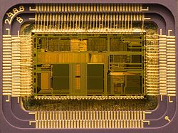
Microprocessor
A silicon chip that contains a CPU.
The terms microprocessor and CPU are used interchangeably.
A microprocessor (sometimes abbreviated µP) is a digital electronic component with miniaturized transistors on a single semiconductor integrated circuit (IC).
One or more microprocessors typically serve as a central processing unit (CPU) in a computer system or handheld device
At the heart of all personal computers and most working stations sits a microprocessor.
Microprocessors also control the logic of almost all digital devices, from clock radios to fuel-injection systems for automobiles

Slide 3
Microprocessor is a programmable device
It can be instructed to perform given tasks with in its capability.
The programmer selects instruction from the list and determines the sequence of execution for a given task.
It takes input from the input device and process the input as it behaves like a CPU and gives the output.
Microprocessor can be divided into three segments
1)ALU
2)Register array
3)Control unit

Slide 4
Input/Output
ALU Register Array
Control
SYSTEM BUS
Memory (RAM/ ROM)

Slide 5
Three basic characteristics differentiate microprocessors:
• Instruction set: The set of instructions that the microprocessor can execute. Eg. RISC or CISC
• Bandwidth: The number of bits processed in a single instruction.
• Clock speed: Given in megahertz (MHz), the clock speed determines how many instructions per second the processor can execute.

Slide 6
History of 8085
Intel's 4004 is considered the first microprocessor (1971) .
It was later followed in 1972 by the 8008, the world's first 8-bit microprocessor.
Then 8080 microprocessor evolved in 1974.
Then comes 8085 in the year 1976

Slide 7
Salient features of 8085
• It is a 8-bit microprocessor.
• It is manufactured with N-MOS technology.
• It has a 16-bit address bus and hence can address up to 2¹⁶ = 65536 bytes (64KB) memory locations through A0-A15.
• The first 8 lines of the address bus and 8 lines of the data bus are multiplexed AD0 – AD7. • Data bus is a group of 8 lines D0 – D7.
• It supports external interrupt request.
• A 16 bit program counter (PC)
• A 16 bit stack pointer (SP)
• Six 8-bit general purpose register arranged in pairs: BC, DE, HL.
• It requires a signal +5V power supply and operates at 5 MHZ clock speed.
• It is enclosed with 40 pins DIP (Dual in line package).

Slide 8
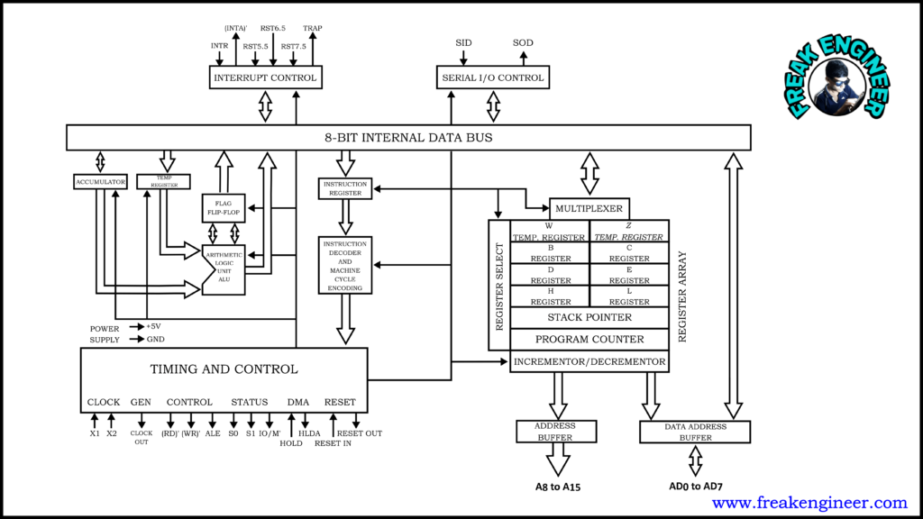
Internal Architecture of 8085

Slide 9
The internal architecture of the 8085 microprocessor determines how and what operations can be performed with the data operations are,
Store 8-bit data.
Perform arithmetic and logical operations.
Test for conditions.
Sequence the execution of instructions.
Store data temporarily in read write memory called stack.

Slide 10
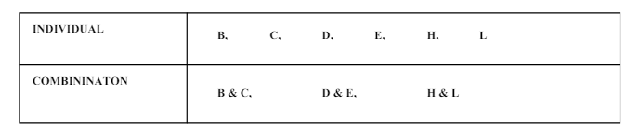
Registers
The 8085 has 6 general purpose registers to store 8-bit data during program execution.
These 6 registers are identified as B, C, D, E, H and L.
They can be combined as register pairs BC, DE and HL to perform some 16-bit operations.
These registers are programmable. It can use to load or transfer data from the registers by using instructions.

Slide 11
Accumulator
The accumulator (A) is an 8-bit register that is part of ALU.
It is used to store 8-bit data and to perform ALU operations.
The result of an operation is stored in Accumulator.
The Accumulator is identified as register A.
The data on which operations is to be performed is operand. One of the operands must be Accumulator.

Slide 12
Program Counter (PC)
This 16-bit register deals with sequencing the execution of instructions.
This register is a memory pointer. Memory locations have 16-bit address.
The microprocessor uses this register to sequence the execution of the instructions.
The function of the program counter is to point to the memory address from which the next byte is to be fetched.
When a byte is being fetched, the program counter is automatically incremented by one to point to the next memory location.

Slide 13
Stack Pointer (SP)
The stack pointer is also a 16-bit register, used as a memory pointer.
It points to a memory location in R/W memory, called stack.
The beginning of the stack is defined by loading 16- bit address in the stack pointer.

Slide 14
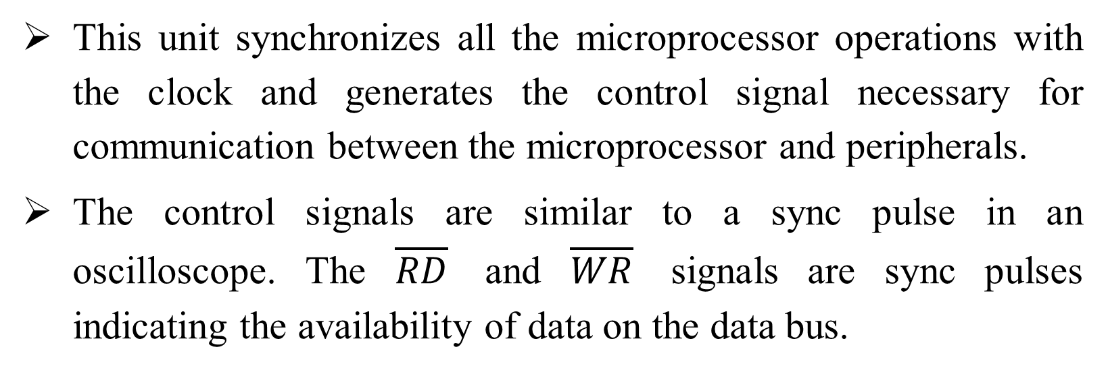
Timing and control unit
This unit synchronizes all the microprocessor operations with the clock and generates the control signal necessary for communication between the microprocessor and peripherals.
The control signals are similar to a sync pulse in an oscilloscope. The $\overline{RD}$ and $\overline{WR}$ signals are sync pulses indicating the availability of data on the data bus.

Slide 15
Instruction register and Decoder
The instruction register and decoder are part of the ALU.
When an instruction is fetched from the memory it is loaded in to the instruction register.
The decoder decodes the instruction and establishes the sequence of events to follow.
The instruction register is not programmable and cannot be accessed by any instruction.

Slide 16
Register Array
There are two additional registers called temporary registers W and Z, which are included in the register array along with programmable registers namely B, C, D, E, H, L, SP and PC.
These registers are used to hold 8-bit data during the execution of instructions. However, they are used internally by microprocessor, they are available to the program.

Slide 17
MUX / DEMUX unit
This unit is used to select a register out of all the available registers.
This unit behaves as Multiplexer (MUX) when data going from the register to the internal data bus.
It behaves as Demultiplexer(DEMUX) when data is coming to a register from the internal data bus of the processor.
The register select will behave as the function of selection lines at the Mux / Demux.

Slide 18
Address Buffer
This is an 8-bit unidirectional buffer.
It is used to drive external high order address bus (A15 – A8).
It is also used to tri-state the high order address bus under certain conditions such as reset, hold, halt and when address lines are not in use.

Slide 19
Address / Data Buffer
This is an 8-bit bi-directional buffer.
It is used to drive multiplexed address/data bus. i.e., low order address bus (A₇-A₀) and data bus (D₇-D₀).
It is also to tri-state the multiplexed address/data bus under certain conditions such as reset, hold, halt and when the bus is not in use.

Slide 20
Incrementer/Decrementer address latch
This 16-bit register is used to increment or decrement the contents of program counter or stack pointer as part of execution of instructions related to them.

Slide 21
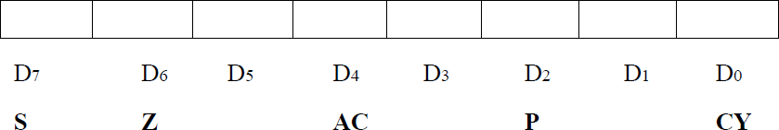
Flag register
The ALU includes five flip-flops, which are set (or) reset after an operation according to data condition of the result in the accumulator and other registers.
They are called Zero (Z), Carry (CY), Sign (S), Parity (P) and Auxiliary Carry (AC) flags.
Their bit positions in the flag register are shown in Fig. The microprocessor uses these flags to test data conditions.

Slide 22
Sign Flag (S) – After any operation if the MSB (B(7)) of the result is 1, it indicates the number is negative and the sign flag becomes set, i.e. 1. If the MSB is 0, it indicates the number is positive and the sign flag becomes reset i.e. 0.
Zero Flag (Z) – After any arithmetical or logical operation if the result is 0 (00)H, the zero flag becomes set i.e. 1, otherwise it gets reset i.e. 0.
Auxiliary Carry Flag (AC) – This flag is used in the BCD number system(0-9). If after any arithmetic or logical operation D(3) generates any carry and passes it on to D(4) this flag becomes set i.e. 1, otherwise, it becomes reset i.e. 0. This is the only flag register that is not accessible by the programmer. AC is set to 1 if carry out from bit 3 on addition or borrows into bit 3 on subtraction happens. Otherwise it is set to 0.

Slide 23
Parity Flag (P) – If after any arithmetic or logical operation the result has even parity, an even number of 1 bits, the parity register becomes set i.e. 1, otherwise it becomes reset i.e. 0.
Carry Flag (CY) – Carry is generated when performing n bit operations and the result is more than n bits, then this flag becomes set i.e. 1, otherwise, it becomes reset i.e. 0. During subtraction (A-B), if A>B it becomes reset, and if (A<B) it becomes set. Carry flag is also called the borrow flag. 1-carry out from MSB bit on addition or borrow into MSB bit on subtraction 0-no carry out or borrow into MSB bit.
Among the 5 flags AC flag is used internally for BCD arithmetic. From the rest four flags, Z and CY are the most commonly used flags.

Slide 24
Interrupts
An interrupt is a signal that temporarily suspends the normal execution of a program and redirects the control to a specific interrupt service routine (ISR).
Interrupts allow the microprocessor to respond to external events, such as user input, system events, or hardware signals, without the need for constant polling

Slide 25
There are five interrupt signals in the 8085 microprocessor:
TRAP: The TRAP interrupt is a non-maskable interrupt that is generated by an external device, such as a power failure or a hardware malfunction. The TRAP interrupt has the highest priority and cannot be disabled.
RST 7.5: The RST 7.5 interrupt is a maskable interrupt that is generated by a software instruction. It has the second highest priority.
RST 6.5: The RST 6.5 interrupt is a maskable interrupt that is generated by a software instruction. It has the third highest priority.
RST 5.5: The RST 5.5 interrupt is a maskable interrupt that is generated by a software instruction. It has the fourth highest priority.
INTR: The INTR interrupt is a maskable interrupt that is generated by an external device, such as a keyboard or a mouse. It has the lowest priority and can be disabled.

Slide 26
HLDA – This is the signal for HOLD acknowledgment that signifies the received signal of HOLD request. When the request is removed, the pin goes to a low state. This is the output pin.
HOLD – This pin indicates that the other device is in the need to utilize data and address buses. This is the input pin.
INTA – This pin is the interrupt acknowledgment that is directed by the microprocessor device after the receival of the INTR pin. This is the output pin.
INTR – This is the interrupt request signal. It has minimal priority when compared with other interrupt signals.

